Slide 1
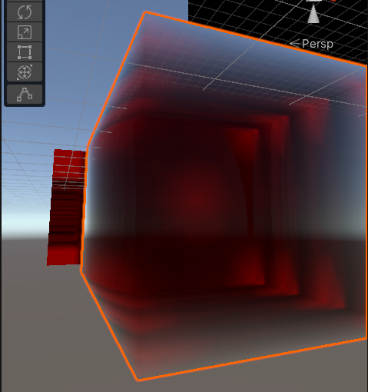
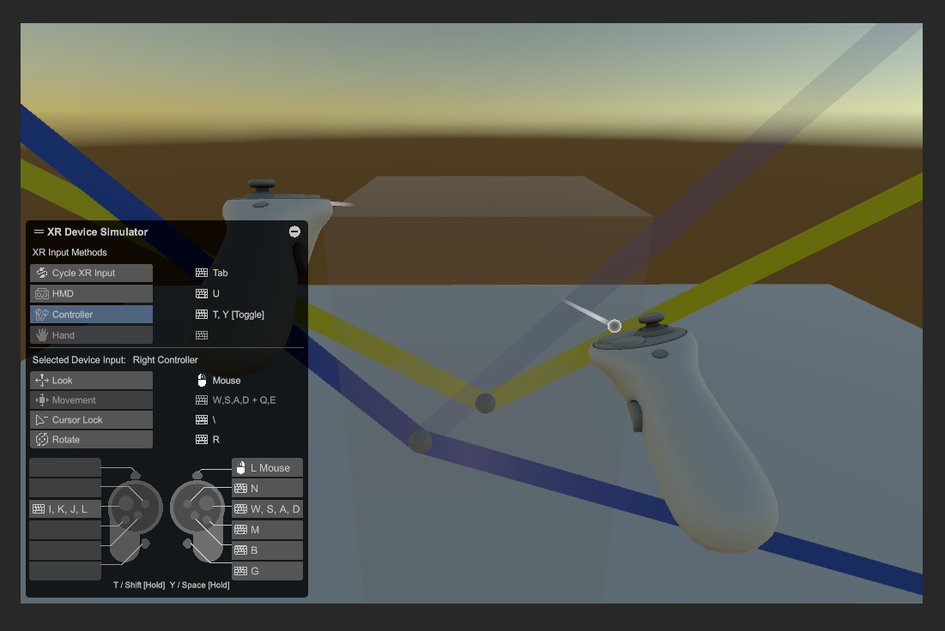
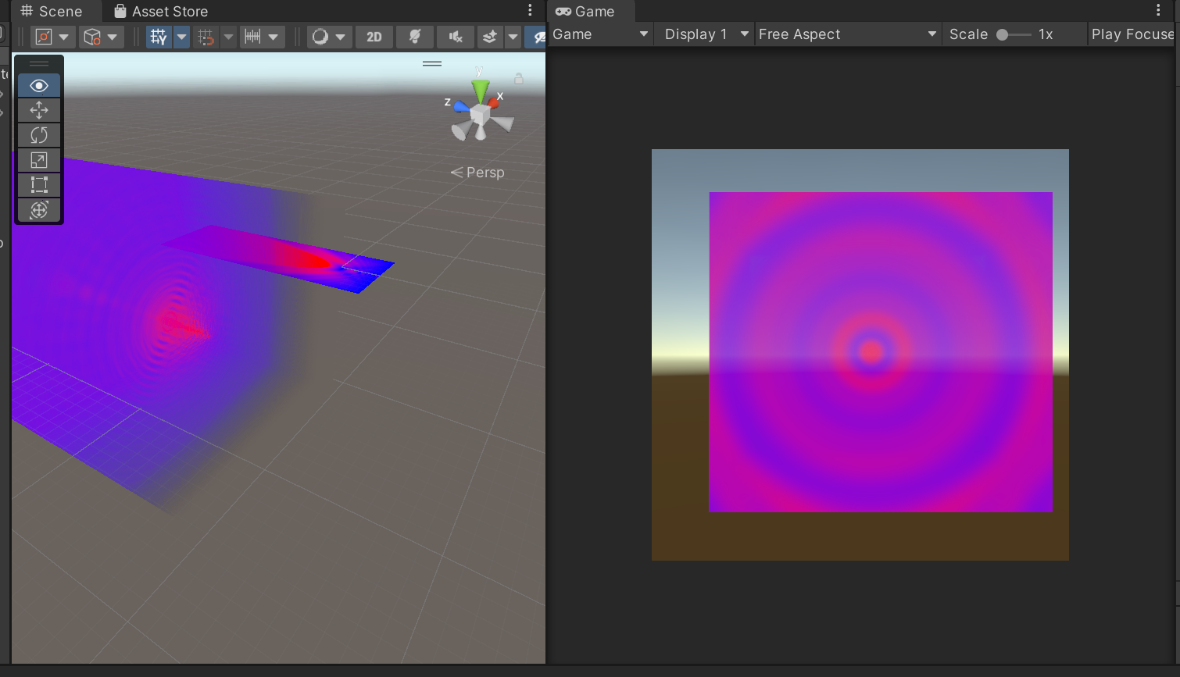
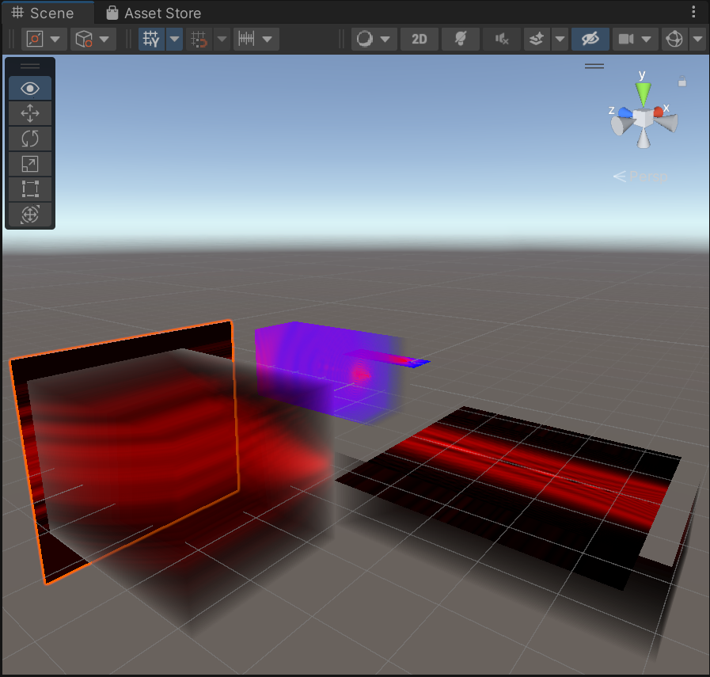
Fresnel Diffraction in 3D and VR - a basic draft of the app
Pucong Li
05.03.2025

Slide 2
Content
1. Definition of the task and aim of project
2. What has been achieved
3. Bugs
4. Futher work

Slide 3
Definition of the task and aim
1. UI in VR
2. Calculate the fields in Unity during program running, or link Python
3. VR rendering in headsets
4. verification of the 360° approximation

Slide 4
What has been achieved
Work status and body health: I feel that my body health can be better though washing nose and taking herbs, this time only work before ddl, worked for about 11-13 hours this week, going to improve💪, has been testing medical solutions for long time
Functions already achieved:
1. Calculations of Aperture diffraction in C#, also rendered in 3D texture, the 3D texture can be saved, or rendered multiple times in real time
2. Clipping plane can also show 2D surface but some bugs existing
3. render in 2 eyes in VR camera, shader modified, VR streaming in Virtual Desktop wirelessly
4. UI creating, but it has shader problem, canvas created but not linked with XR interactions yet

Slide 5
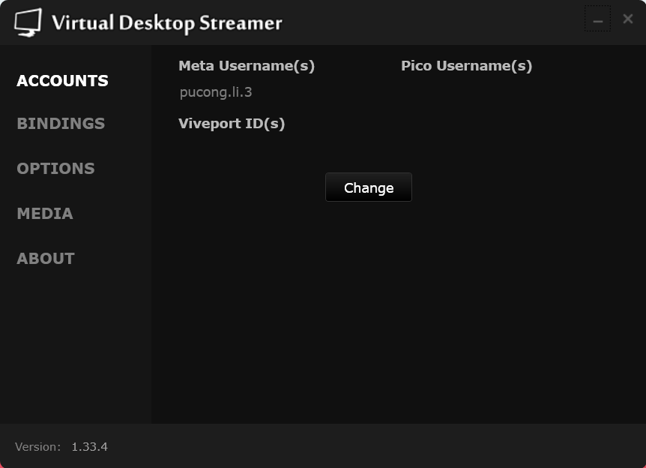
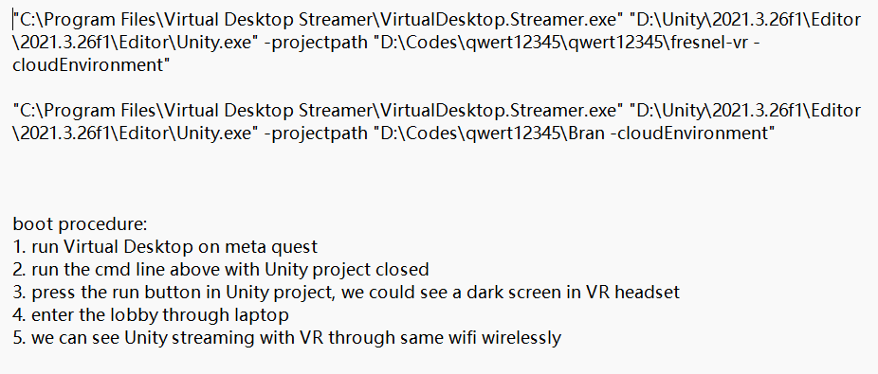
What has been achieved
Streaming with Virtual Desktop, an alternative way, try quest link later,
≈15€ software, long time ago, streaming result estimated = quest link based on experience during lecture

Slide 6
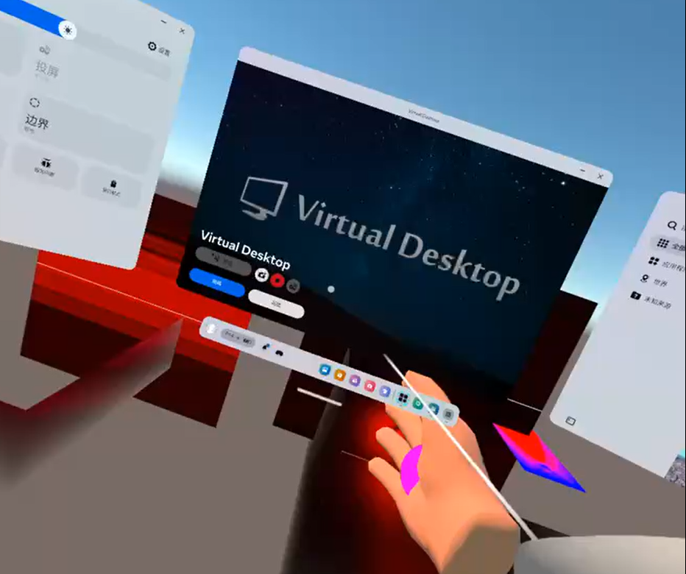
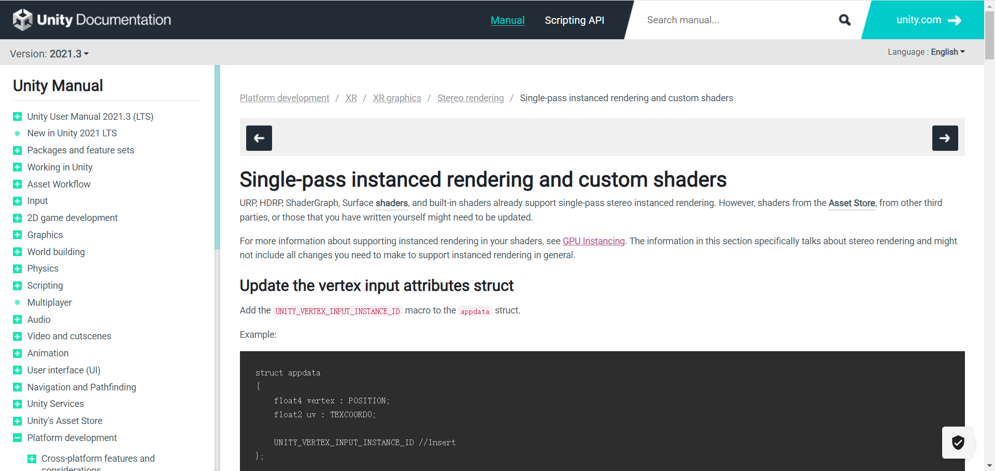
What has been achieved
Rendering in stereo mode(2 eyes) + steering of the user + network(enter the lobby as HMD)

Slide 7
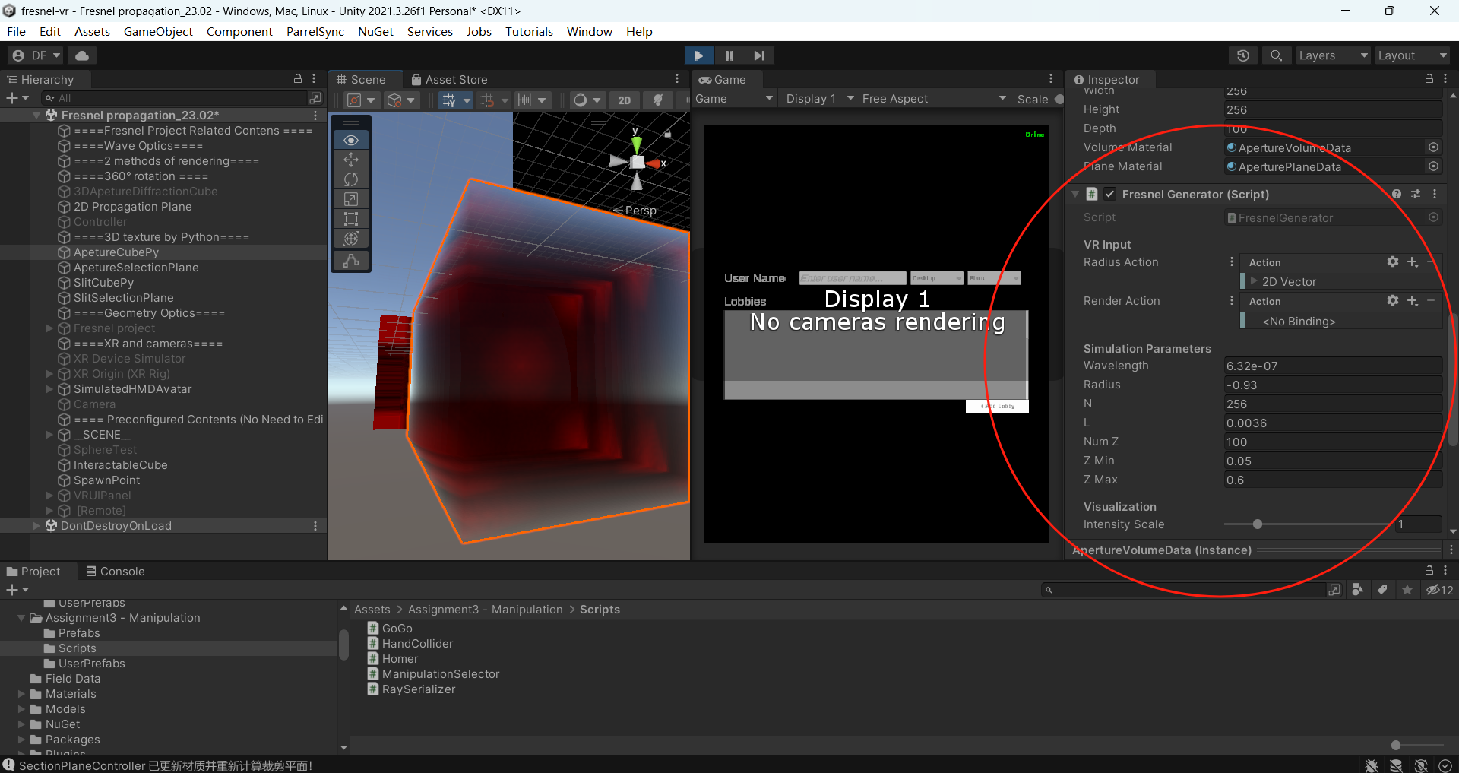
What has been achieved
MathNet + NuGet, new packages, finer and more beautiful result, like crystal

Slide 8
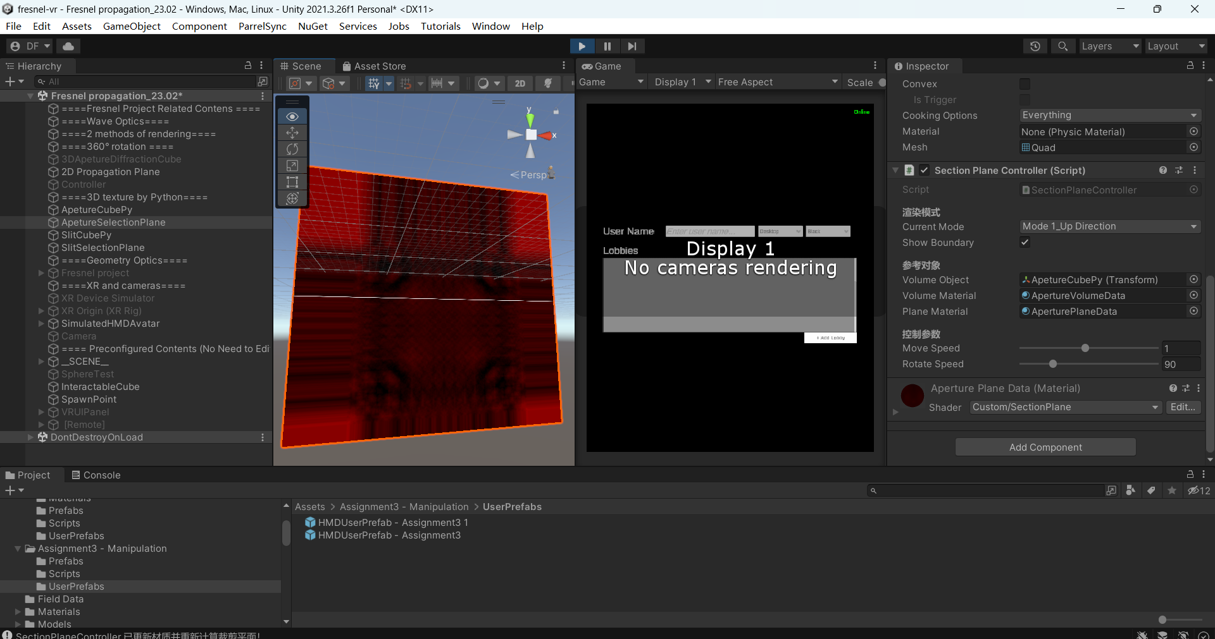
What has been achieved
MathNet + NuGet, new packages, finer and more beautiful result, like crystal

Slide 9
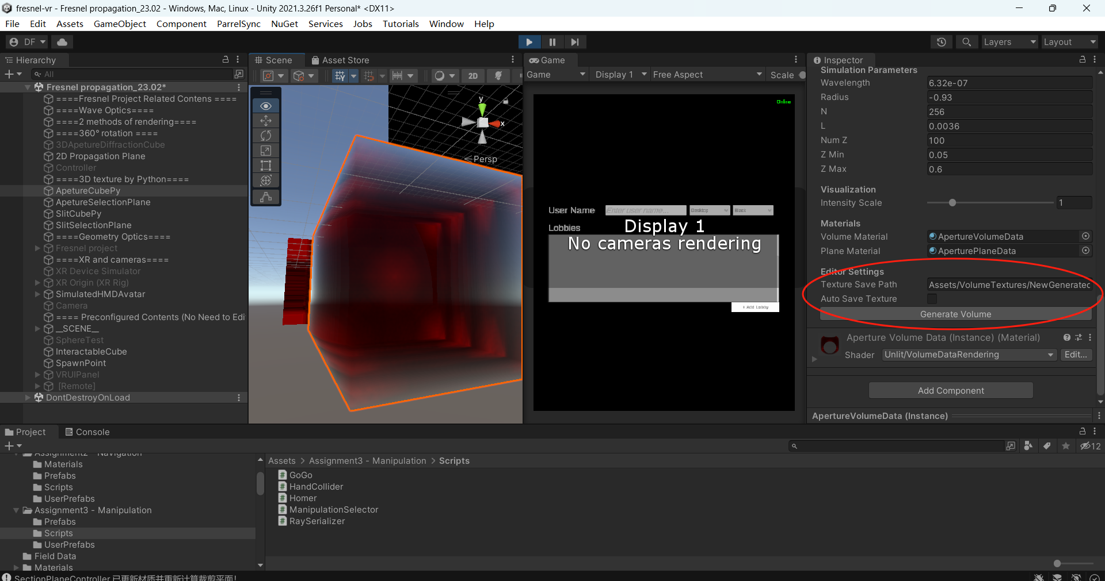
What has been achieved
real time/render 3D texture one by one

Slide 10
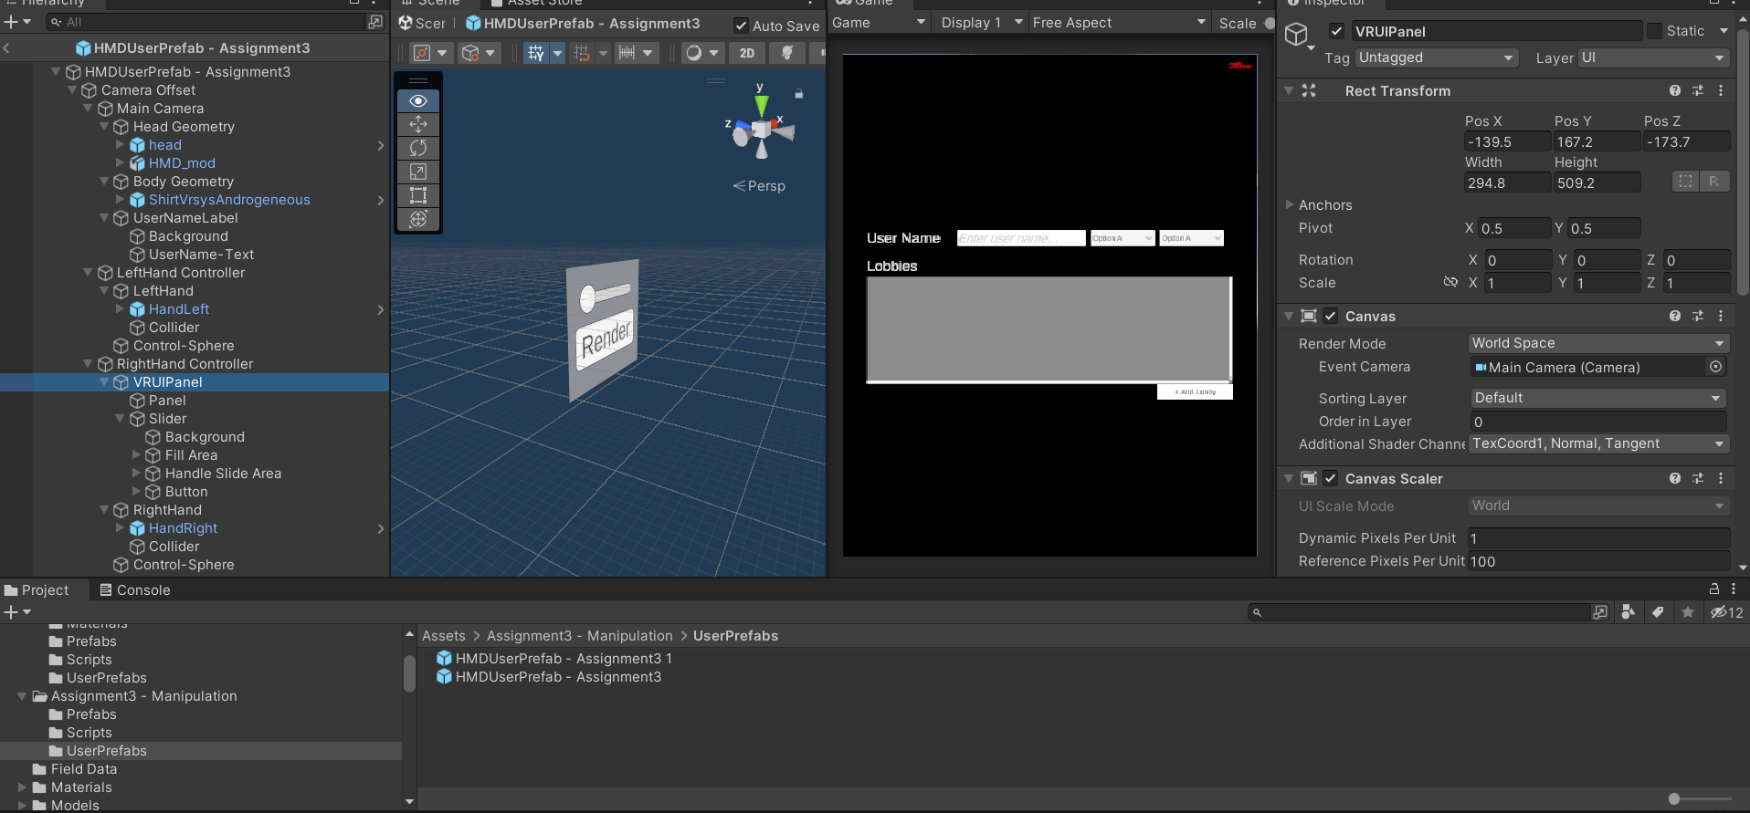
What has been achieved

Slide 11
Bugs
1. clipping plane rendering, the shader is controlled by: Fresnel generator in multiple times + clipping controller + maybe others
2. potential memory problem or Unity crash
3. Canvas rendering with wrong shader
4. Diffraction pattern duplicated generating

Slide 12
Further work
1. UI in VR, interactions
2. slit diffraction in C#
3. colorspace and so on
4. Theory part, equation derivation, a new type of approximation..?
5. potential meta quest link
6. git LFS, or organize manifest and dependencies
Other personal plans which could be helpful: ios develpment, some mods of games based on my own interest, going to improve and recover body health

Slide 13
Thank you for your attention!

